Slide 1
Solid Shapes
and their Properties

Slide 2
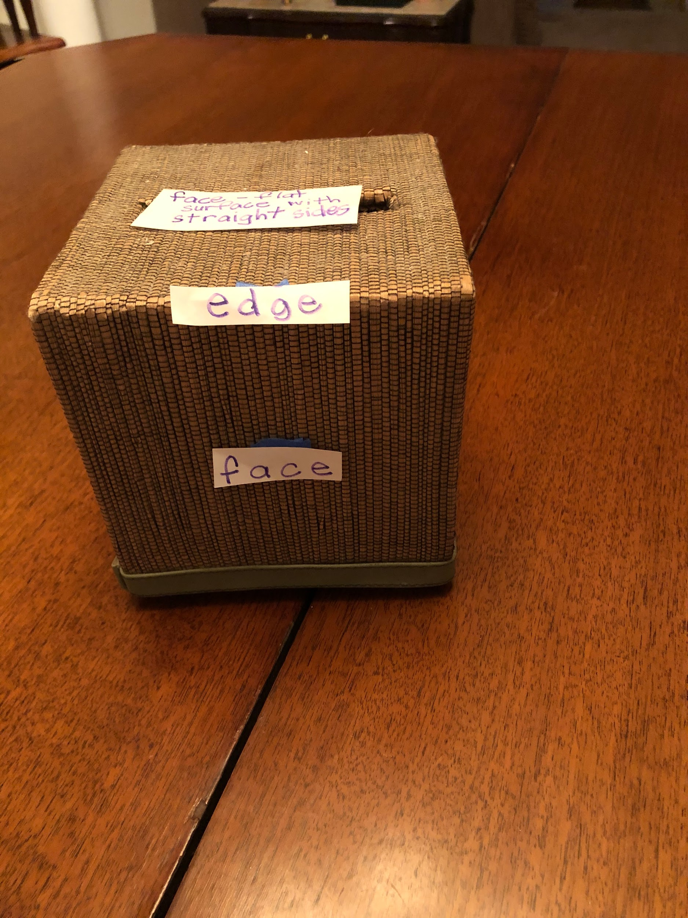
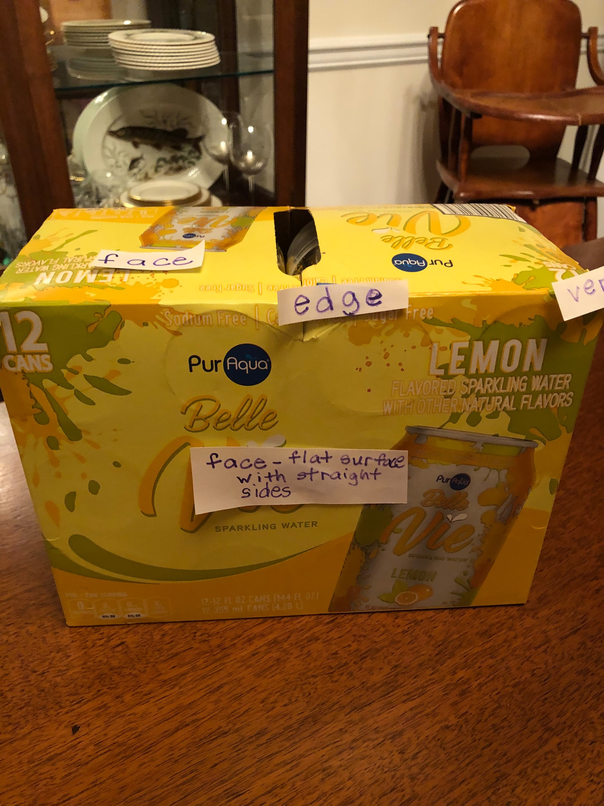
Rectangular Prisms and their Properties
A cube is rectangular prism and This is a rectangular prism. every side is the exact same size.
Notes:
This solid figure is a cube and a rectangular prism.

Slide 3
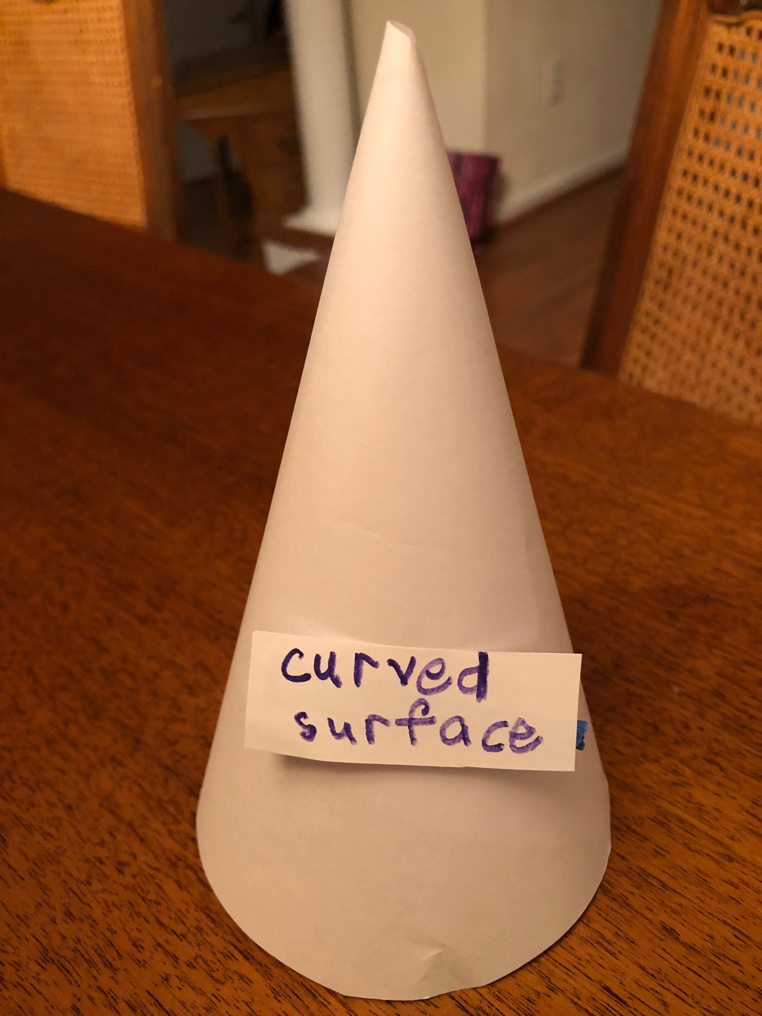
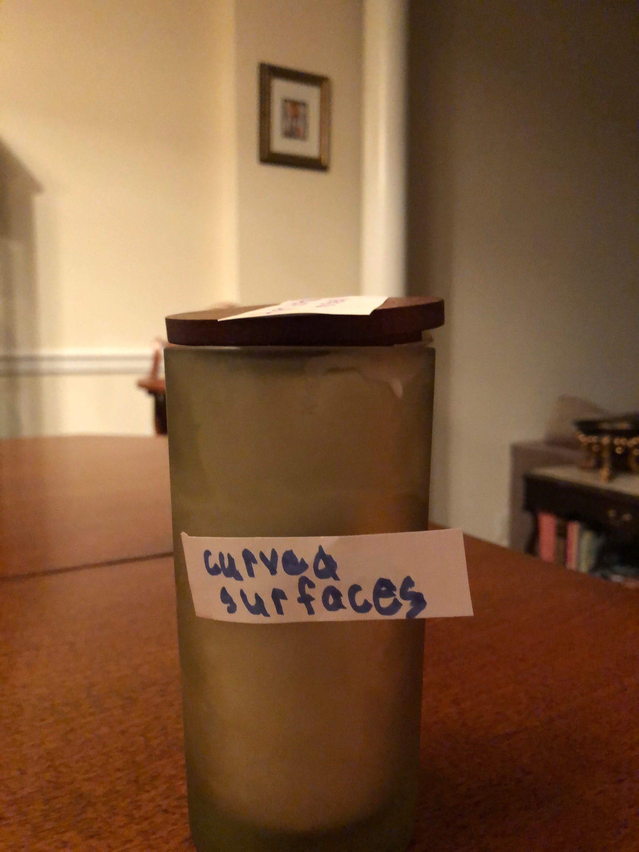
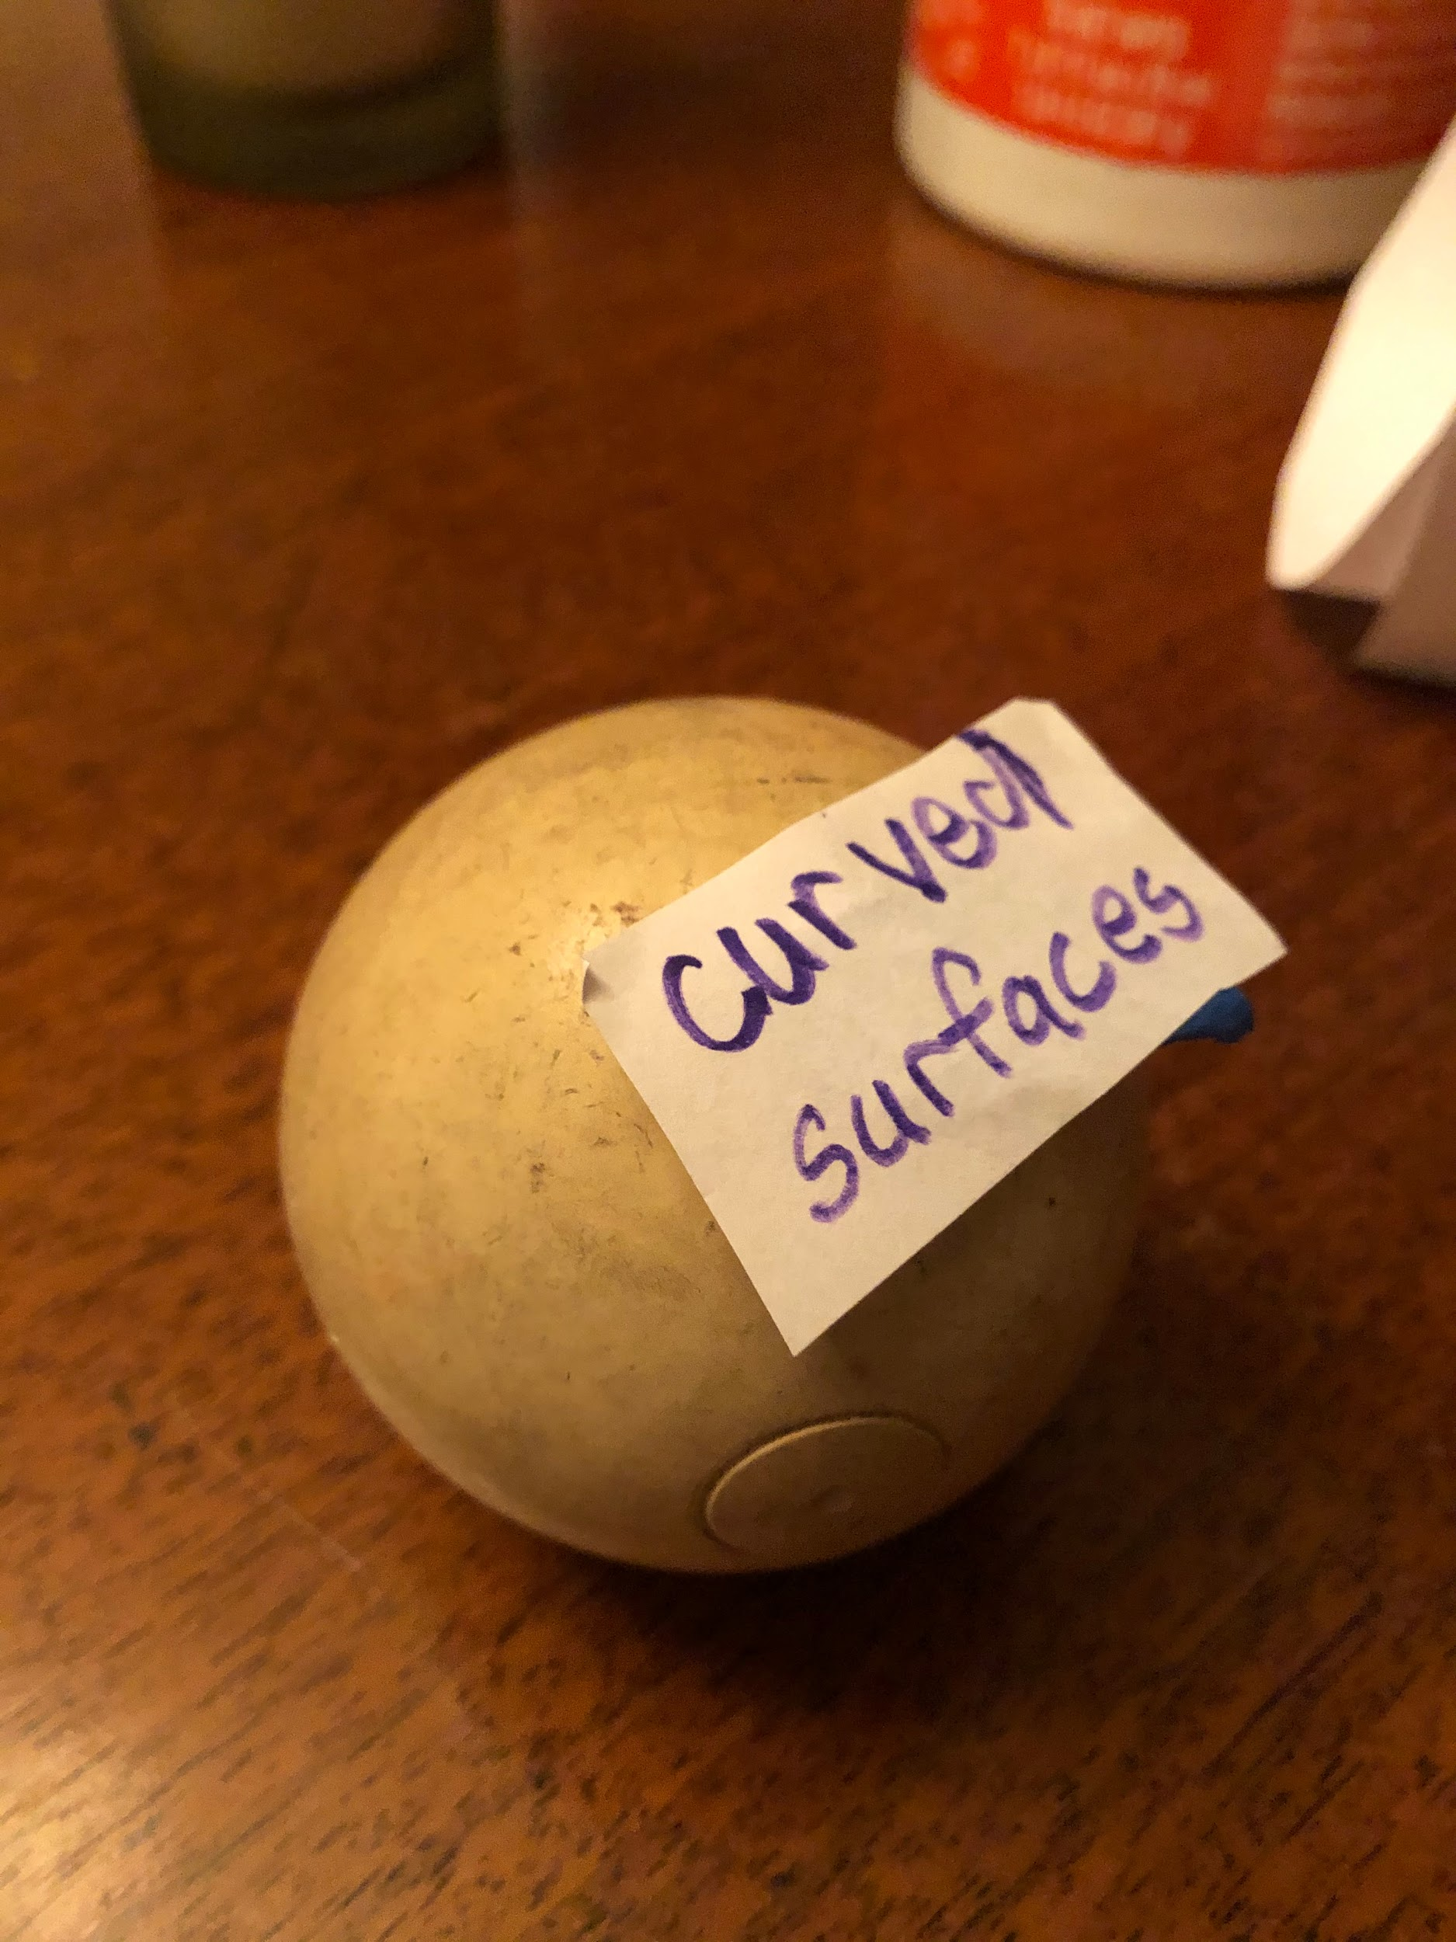
Cone Cylinders Sphere

Slide 4
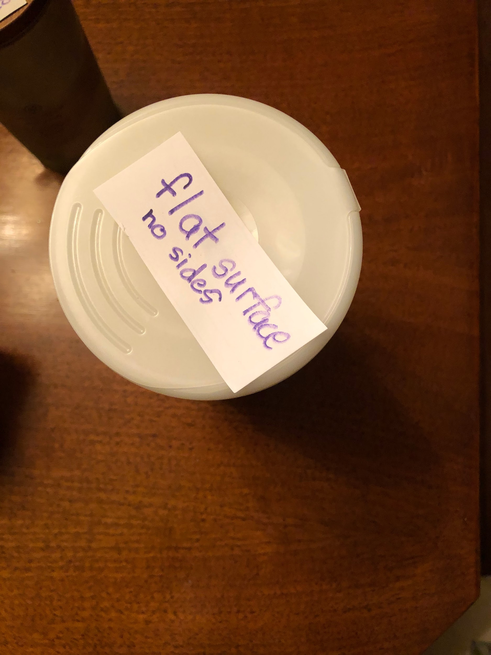
Flat Surfaces do NOT have straight sides.

Slide 5
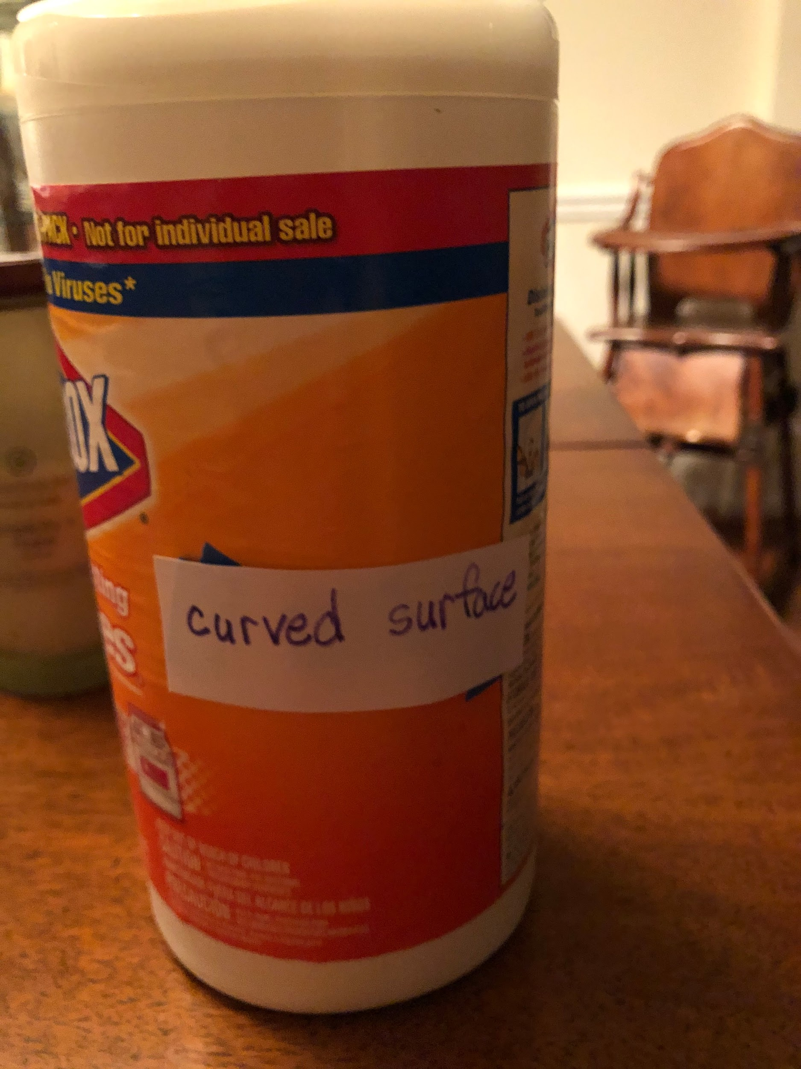
Curved Surfaces

Slide 6
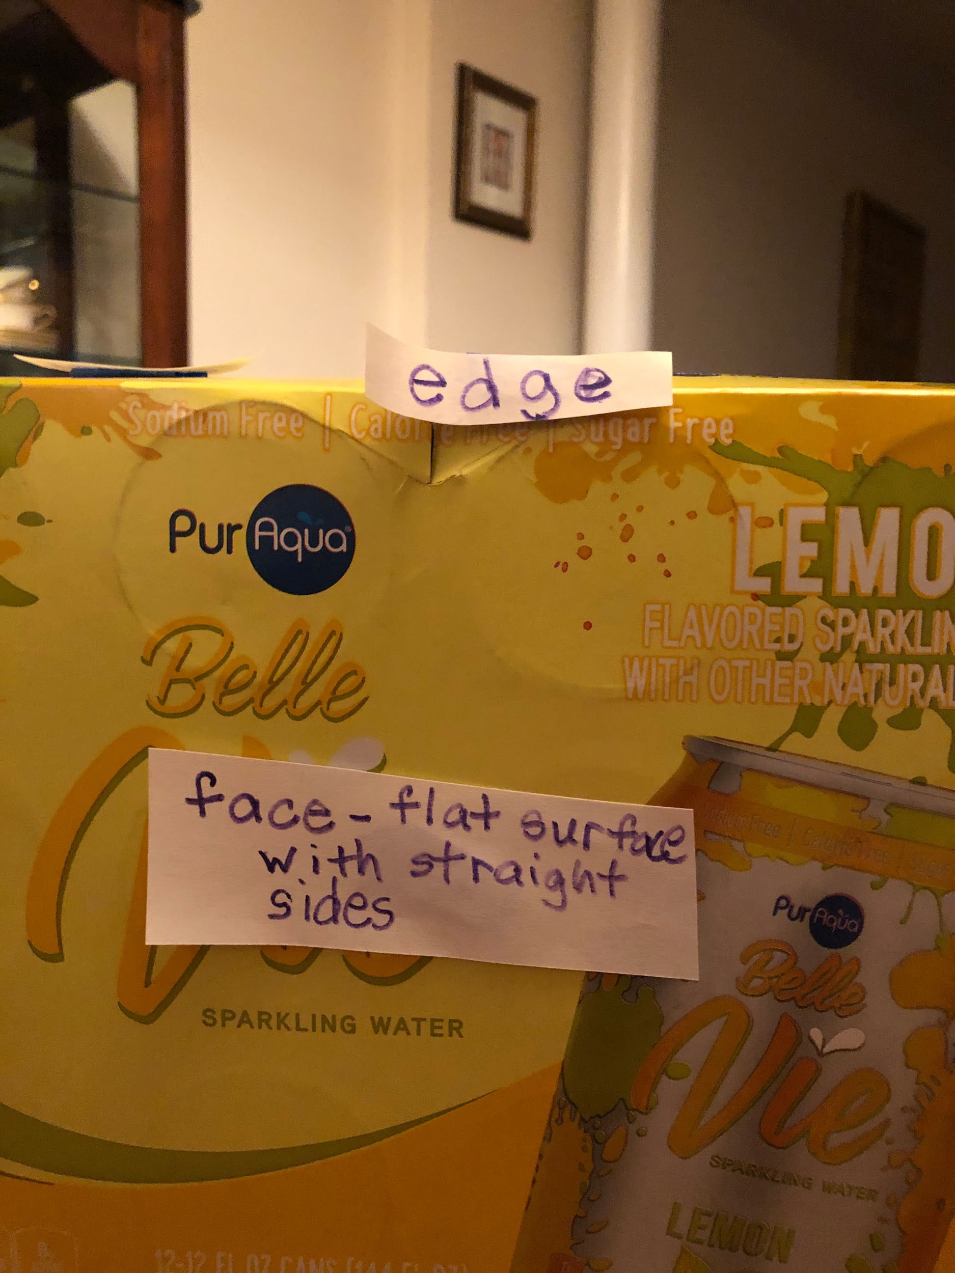
Faces are flat surface WITH STRAIGHT EDGES

